Slide 1
watermark based Electronic patient record(epr) hiding using integer wavelet transform
By,
Sovan Sarkar
Sourom Sagar Bhagat
Ramakrishna Mission
Residential College

Slide 2
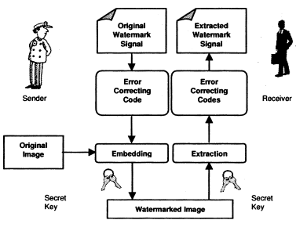
Watermarking
Applications:
Copyright Protection:
Watermarking can be used to protecting redistribution of copyrighted material over the untrusted network like Internet or
peer-to-peer (P2P) networks.
Content Archiving:
Watermarking can be used to insert digital object identifier or serial number to help archive digital contents like images, audio or video.
Meta-Data Insertion:
Meta-data refers to the data that describes data. Images can be labelled with its content and can be used in search engines.
Tamper Detection:
Digital content can be detected for tampering by embedding fragile watermarks. If the fragile watermark is destroyed or degraded, it indicated the presence of tampering and hence the digital content cannot be trusted.
Digital Fingerprinting:
Digital Fingerprinting is a technique used to detect the owner of the digital content. Fingerprints are unique to the owner of the digital content.
Watermarking is a branch of information hiding which is used to hide proprietary information in digital media. A watermarking algorithm embeds a visible or invisible watermark in a given multimedia object. The embedding process is guided by use of a secret key which decided the locations within the multimedia object (image in our case) where the watermark would be embedded. Using the secret key, the embedded watermark sequence can be extracted. This extracted watermark may or may not resemble the original watermark because the object might have been attacked.
Requirements
Transparency: The digital watermark should not affect the quality of the original image after it is watermarked.
Robustness: Cox et al. (2002) defines robustness as the "ability to detect the watermark after common signal processing operations".
Capacity: Capacity or data payload as "the number of bits a watermark encodes within a unit of time or work". Watermark should be able to carry enough information to represent the uniqueness of the image.
Basic Watermarking

Slide 3
Comparison
A brief comparison between Watermarking and Steganography.
Watermarking
Steganography
Watermarking is used to verify the identity and authenticity of the owner of a digital image. It is a process in which the information which verifies the owner is embedded into the digital image or signal. Watermarking is of two main types. Invisible and Visible.
Applications:
Copyright Protection
Source Tracing
Annotations
Steganography is changing the image in a way that only the sender and the intended recipient is able to detect the message sent through it. It is invisible, and thus the detection is not easy. Large media files are considered ideal for steganography.
Applications:
Modern printers.
Intelligence Services

Slide 4
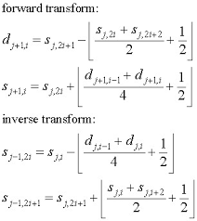
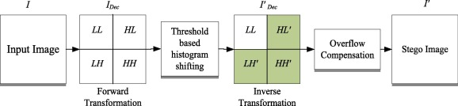
INTERGER WAVELET TRANSFORM
For integer-encoded signals, an integer wavelet transform (IWT) can be particularly efficient. The IWT is an invertible integer-to-integer wavelet analysis algorithm. You can use the IWT in the applications that you want to produce integer coefficients for integer-encoded signals.
The IWT is not only computationally faster and more memory-efficient but also more suitable in lossless data-compression applications. The IWT enables you to reconstruct an integer signal perfectly from the computed integer coefficients.
Standard IWT Procedure

Slide 5
Literature survey
Concise summaries of referred articles

Slide 6
Literature survey
Continued
1. Vidyasagar M. Potdar, Song Han, Elizabeth Chang, 2005, 3rd IEEE International Conference on Industrial Informatics, A Survey of Digital Image Watermarking Techniques, Curtin University of Technology, Perth, Western Australia.
A detailed study of topics such as Watermarking, Watermark Detection, Spatial Domain, Image Transforms, DWT, DCT, DFT.
2. Piyu Tsai, Yu-Chen Hu, Hsiu-Lien Yeh, 2008, Reversible Image Hiding Scheme using Predictive Coding and Histogram Shifting, National United University, Miaoli, Taiwan.
Method: Region Based Histogram Shifting, (Reversible)
A reversible image hiding scheme based on histogram shifting for medical images is proposed. The similarity of neighbouring pixels in the images was explored by using the prediction technique and the residual histogram of the predicted errors of the host image was used to hide the secret data in the proposed scheme. In addition, the overlapping between peak and zero pairs was used to further increase the hiding capacity. To enlarge the hiding capacity of the histogram-based scheme, the linear prediction technique is employed to process the cover image.
Compared to the histogram-based method, the quality of the stego-image improved about 1.5 dB when the same amounts of secret data were embedded. The PSNR of the proposed method stood at 52.95 while the PSNR of the histogram-based scheme was at 51.33.

Slide 7
Literature survey
Continued
3. Qin, C.-C. Chang, Y.-H. Huang, L.-T. Liao, (2013), An Inpainting-assisted reversible steganographic scheme using a histogram shifting mechanism, IEEE Trans. Circuits Syst. Video Technol. 23
Method: Region Based Spatial Domain Histogram Shift, (Reversible)
Data hiding based on Histogram shift. The method used an image inpainting based prediction model. The reference pixels are determined adaptively based on the image characteristics. Less number of reference points gets selected from smooth regions and a high number of reference pixels are chosen from the high-fidelity regions in the image area. The secret information is then hidden reversibly over the histogram of the predicted error image.
The PSNR for this method was 65db for medical images and 45db for “Lena” image.
4. Sunil Lee, Student Member, IEEE, Chang D. Yoo, Member, IEEE, and Ton Kalker, Fellow, IEEE, 2007, Reversible Image Watermarking Based on Integer-to-Integer Wavelet Transform, IEEE TRANSACTIONS ON INFORMATION FORENSICS AND SECURITY, VOL. 2, NO. 3, SEPTEMBER 2007.
Method: Least Significant Bit substitution on high-frequency wavelet sub bands.
Proposes a high capacity reversible image watermarking scheme based on integer-to-integer wavelet transforms. The proposed scheme divides an input image into nonoverlapping blocks and embeds a watermark into the high-frequency wavelet coefficients of each block.
The PSNR for this method was 44.87db for “Lena” image and 38.56db for “Baboon” image.

Slide 8
Literature survey
Continued
5. Hêmin Golpîra, Habibollah Danyali, 2009, Reversible Blind Watermarking for Medical Images Based on Wavelet Histogram Shifting, University of Kurdistan, Sanandaj, Iran
Method: Histogram Shifting in Wavelet Domain
This paper proposes a blind reversible watermarking approach for medical images based on histogram shifting in wavelet domain. According to the capacity required for the watermark, two thresholds, T1 and T2, are selected, one in the begging part and the other in the end part of the histogram of the high frequency sub bands of the transformed image. Two zero-points, Z1 and Z2 are also created by properly shifting the beginning and the end parts of the histogram. The part of the histogram located between the two thresholds remains unchanged.
The PSNR for this method was 53db for several watermarked medical images.
6. Ladan Salimi, Amir Haghighi, Abdolhossein Fathi, 2018, A Novel Watermarking Method Based on Differential Evolutionary Algorithm nd Wavelet Transform, Multimedia Tools and Applications (2020)
Method: Watermarking method based on the optimization framework and discrete wavelet transform, using differential evolution algorithm.
Watermarking method based on the optimization framework and discrete wavelet transform (DWT) is presented. In this method, first, the watermark image is divided into several blocks. Then, using differential evolution (DE) algorithm, an appropriate location for each of these blocks is found in the cover image. In the proposed method, the results of the DE algorithm, which is needed for the reconstruction phase are also embedded as a vector in the cover image under the wavelet domain.
The PSNR for this method was 64.3±2.0db for several watermarked medical images.

Slide 9
Literature survey
Continued
7. Hamza A. Ali, Sama’a A. K. Khamis, 2012, Robust Digital Image Watermarking Technique Based on Histogram Analysis, University of Basrah, Iraq.
Method: Histogram Equalization
The proposed watermarking technique relies on modification efforts to the histogram of the frequency of occurrence of pixels intensities in a digital image. The carrier image is first segmented into blocks, a histogram for each block is plotted and the maximum value of the pixels is changed by a predefined value.
The PSNR for this method was 39.13db for several watermarked medical images.
8. Gurong Xuan et. Al., 2006, Lossless Data Hiding Using Histogram Shifting Method Based on Integer Wavelets, Tongji University, P.R. China
Method: Integer Wavelet Transformation
Discusses a method focused on lossless information hiding, which aims to hide data in an image without causing any damage and retrieve the hidden data accurately. The algorithm used in this method involves histogram shifting and divides the image into four sub bands of frequency: LL, LH, HL, and HH. The payload, converted into bits, is then embedded into the image using Wavelet Histogram Shifting with the concept of Zero Points. In this process, the target frequency is increased by 1, and the consecutive frequencies are adjusted accordingly. The method of extracting the hidden data follows the reverse process of the embedding process.
The PSNR for this method was around 52-56 for the USC SIPI database.

Slide 10
Literature survey
Continued
9. A. Giakoumaki, S. Pavlopoulos, D. Koutsouris ,2003, A medical image watermarking scheme based on wavelet transform, National Technical University of Athens, Greece.
Method: Haar Transform
A wavelet-based multiple watermarking scheme is proposed to address medical confidentiality, origin authentication, and data integrity. The scheme embeds three types of watermarks: a robust watermark with the doctor's digital signature, a caption watermark with patient and examination data, and a fragile watermark for integrity control. This scheme provides a comprehensive solution for managing and distributing medical data. Experimental results demonstrate its efficiency and ability to meet the strict requirements for acceptable alterations of medical images.
The PSNR for this method was 41.98dB for several medical images.
10. Shabir. A. Parah et. Al., 2015, A Robust Medical Image Watermarking System for E-healthcare
Method: Discrete Cosine Transform
The paper proposes two watermarking algorithms for medical images in the transform domain. The first algorithm embeds a digital watermark and Electronic Patients Record (EPR) in both the region of interest (ROI) and the region of non-interest (RONI). The second algorithm keeps the ROI untouched and embeds the watermark and EPR only in the RONI. Both algorithms utilize an 8×8 block-based discrete cosine transform (DCT) and modify selected DCT coefficients based on their magnitudes and a threshold to embed the watermark/EPR. These techniques are robust against singular and hybrid attacks.
The average PSNR for this method was 54dB for several medical images.

Slide 11
Literature survey
Continued
11. C. Vinoth Kumar, V. Natarajan and Deepika Bhogadi, 2013, High Capacity Reversible Data hiding based on histogram shifting for Medical Images
Method: Hierarchical Block Division for Histogram-Shifting Data Hiding
This paper introduces a modified histogram shifting algorithm to enhance the hiding capacity in reversible medical image watermarking. The algorithm involves hierarchically dividing the cover image into smaller blocks and using histogram shifting for data embedding. To achieve optimal data hiding, a recursive looking-ahead estimation technique is employed to determine the maximum data hiding volume at the lowest block level. The block divisions are performed based on the hiding capacity, and a modified block division scheme is specifically designed for medical images with extensive dark areas.
The PSNR for this method was 51.13 to 59.05dB for several medical images.
12. Sujarani Rajendran , Manivannan Doraipandian, 2016, Chaotic Map Based Random Image Steganography Using LSB Technique
Method: Discrete Cosine Transform
This paper aims to propose a new symmetric key based image hiding technique. Pseudo random keys are generated by using 1D logistic map and those keys are used for choosing the pixel position of cover image randomly for hiding the secret image. The main security part of the projected method is the selection of pixel position in the cover image
The average PSNR for this method was 44dB for several medical images.

Slide 12
Literature survey
Continued
13.
Method: Haar Transform
The PSNR for this method was 41.98dB for several medical images.
14.
Method: Discrete Cosine Transform
The average PSNR for this method was 54dB for several medical images.

Slide 13
Proposed Methodology
(The methodology applied so far).

Slide 14
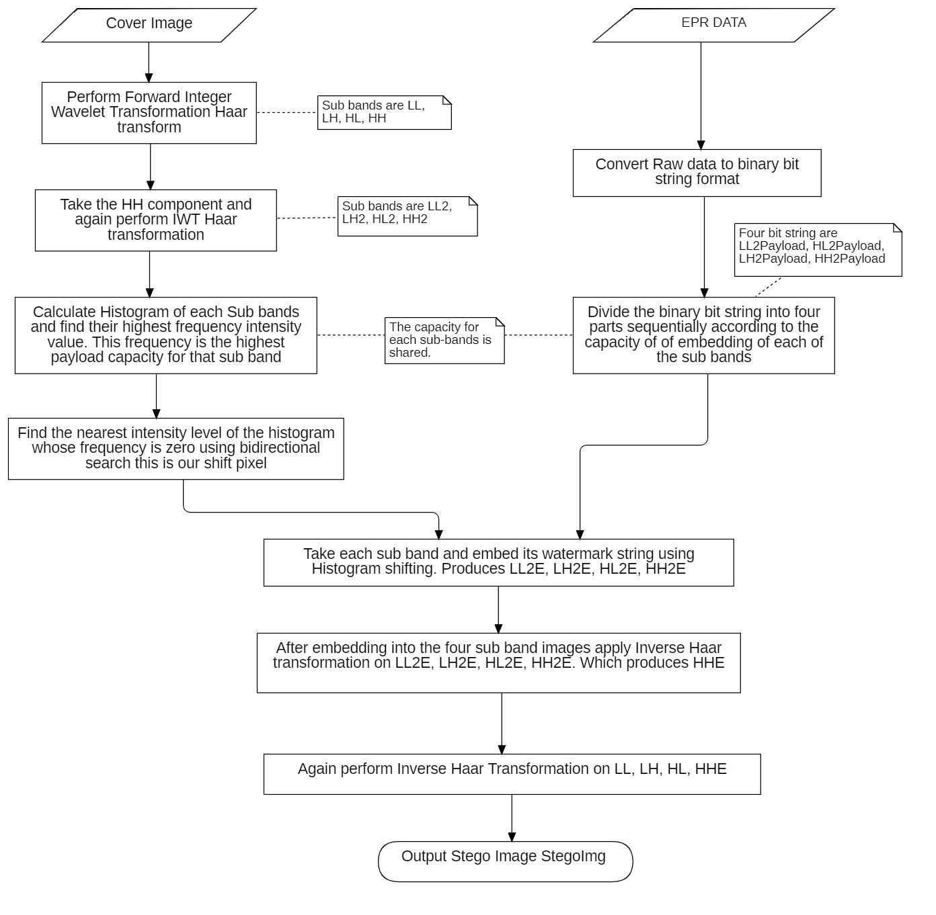
Embedding process(Flowchart)

Slide 15
Forward IWT harr transform
LL1
HL1
Cover Image
LH1
HH1
Forward IWT harr transform
LL2
HL2
HH1
LH2
HH2

Slide 16
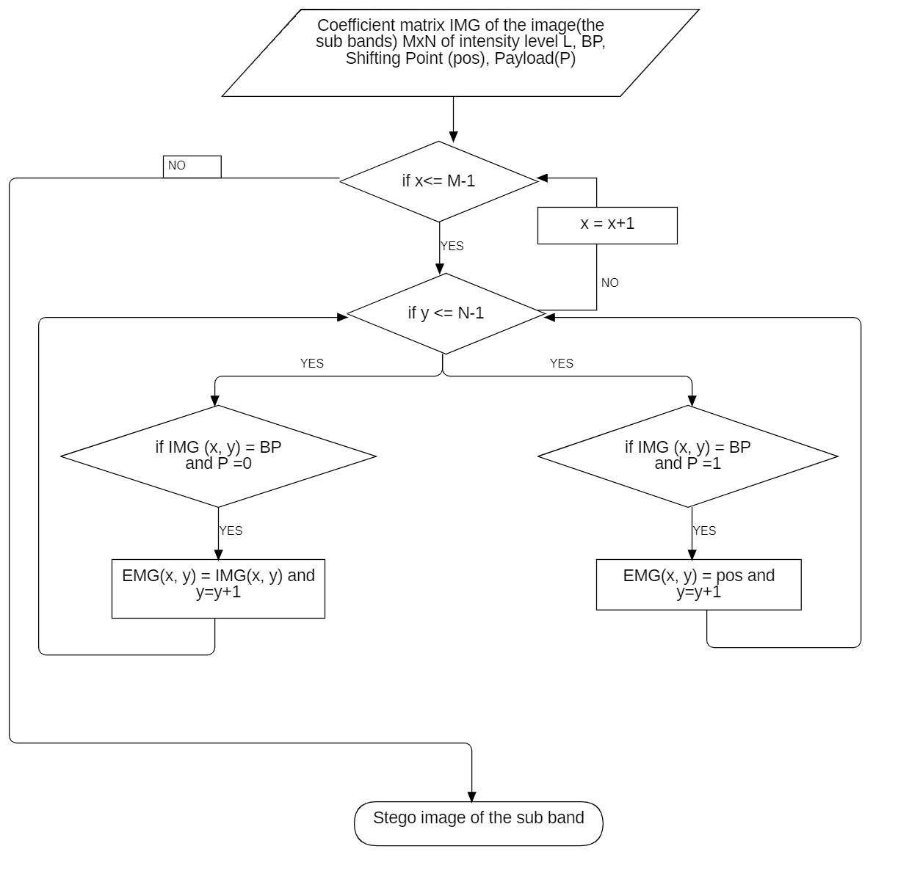
Histogram shifting flowchart

Slide 17
Numerical example (histogram shifting)
Lets take a payload “10110” which is to be embedded
0 | 3 | 4 | 5
4 | 5 | 1 | 4
3 | 0 | 4 | 3
6 | 4 | 3 | 8
Histogram
take 4 as BP as it has the highest frequency
2 | 1 | 0 | 4 | 5 | 2 | 1 | 0 | 1 | 0
0 | 1 | 2 | 3 | 4 | 5 | 6 | 7 | 8 | 9
IMG
Taking 2 as the shifting point

Slide 18
Numerical example (histogram shifting)
BP is 4, Shifting point is 2 and the payload is “10110”
2 | 1 | 0 | 4 | 5 | 2 | 1 | 0 | 1 | 0
0 | 1 | 2 | 3 | 4 | 5 | 6 | 7 | 8 | 9
0 | 3 | 4 | 5
4 | 5 | 1 | 4
3 | 0 | 4 | 3
6 | 4 | 3 | 8
0 | 3 | 2 | 5
4 | 5 | 1 | 2
3 | 0 | 2 | 3
6 | 4 | 3 | 8
If IMG(x, y) ==4 and payloadBit == 1 then StegoIMG(x, y) = 2
IMG
StegoIMG

Slide 19
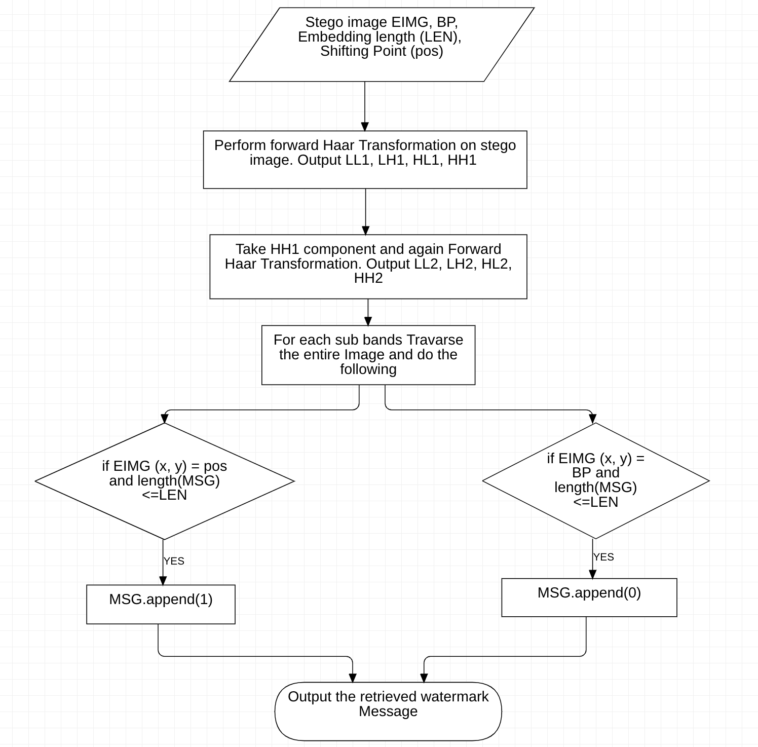
decoding process (flowchart)

Slide 20
Numerical example: decoding
BP = 4 and shifting point =2
Travarse the image
0 | 3 | 2 | 5
4 | 5 | 1 | 2
3 | 0 | 2 | 3
6 | 4 | 3 | 8
If StegoImg(x, y) == 2 then MSG.append(1) and RIMG(x, y) = 4
recover_list = 10110
If StegoImg(x, y) == BP then MSG.append(0)
StegoIMG

Slide 21
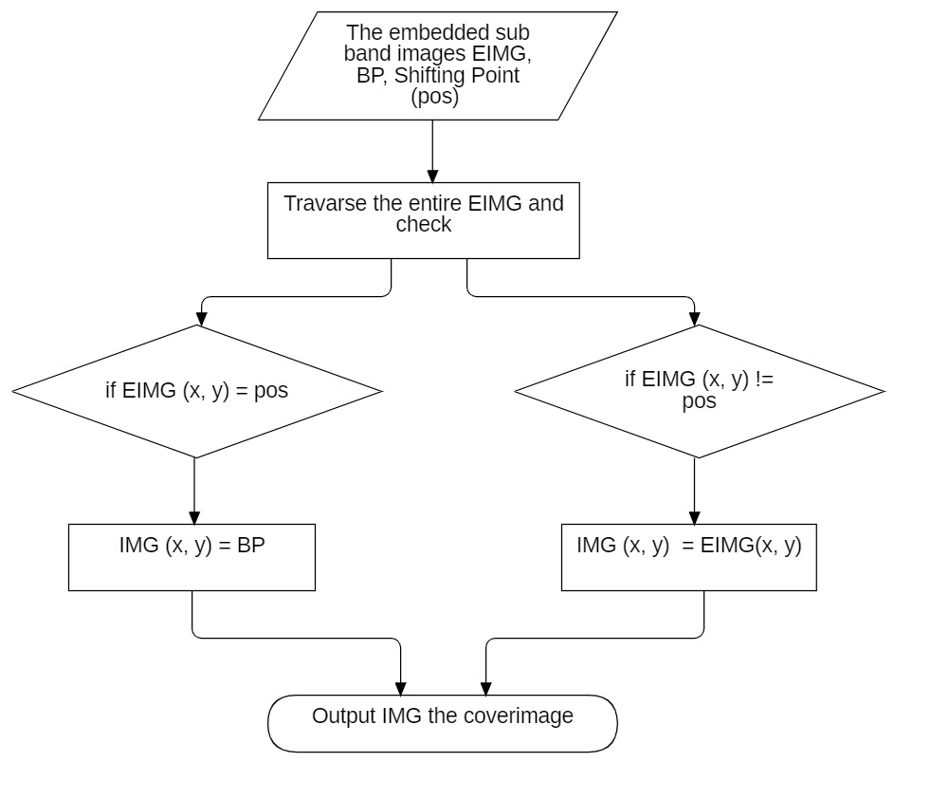
Reconstructing cover image process (flowchart)

Slide 22
Numerical: Reconstructing cover image process
Travarse the image
0 | 3 | 2 | 5
4 | 5 | 1 | 2
3 | 0 | 2 | 3
6 | 4 | 3 | 8
0 | 3 | 4 | 5
4 | 5 | 1 | 4
3 | 0 | 4 | 3
6 | 4 | 3 | 8
If StegoImg(x, y) == 2 then RIMG(x, y) = 4
Else RIMG(x, y) = StegImg(x, y)

Slide 23

Doctor: Sovan Hospital Code: ABC_HOSPITAL_64 image: Brain Cancer Patient Name: Temp Roy Copyright: Sovan
Cover Image
Stego Image

Slide 24
Recovering epr data and constructing Original Cover Image
Reversible Image
Doctor: Sovan Hospital Code: ABC_HOSPITAL_64 image: Brain Cancer Patient Name: Temp Roy Copyright: Sovan
Stego Image
Recovery 100% without attack

Slide 25
Performance evaluation
Used to evaluate the performance of the proposed method.

Slide 26
Performance evaluation methods.
PSNR, SSIM, and Normalized Cross-Correlation are all metrics used to measure the similarity between two images.
PSNR measures the difference between two images based on the noise level.
SSIM measures the similarity between two images based on the structure and contrast.
NCC measures the similarity between two images based on their pixel values.

Slide 27
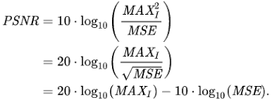

Peak Signal-to-Noise Ratio (PSNR):
A higher PSNR value means that the difference between the two images is smaller.
It is a commonly used metric in image processing to measure the quality of an image compared to a reference or original image.
It measures the ratio between the maximum possible power of a signal and the power of corrupting noise that affects the fidelity of its representation.
PSNR is expressed in decibels (dB) and a higher value indicates a better quality image.
Where MAXI is the maximum number of intensities in the image. For example, for an 8-bit image, it would be 255.
N is the number of cover image pixels.
C_{i} is the intensity of i^{th} pixel in the watermarked-image.
C_{i} is the intensity of i^{th} pixel in the cover image.

Slide 28
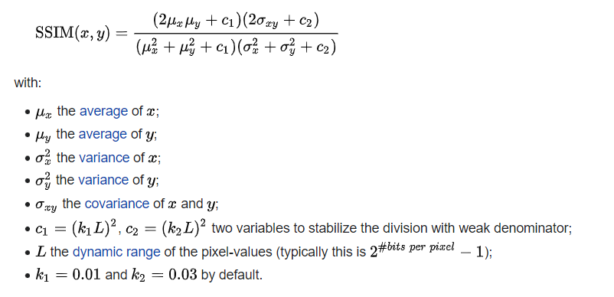
Structural Similarity Index (SSIM):
SSIM values range from -1 to 1, with 1 indicating perfect similarity between the two images.
It is a perceptual metric that is designed to measure the similarity between two images based on their structural information.
SSIM takes into account the luminance, contrast, and structural similarity of the two images.
SSIM values range from -1 to 1, with 1 indicating perfect similarity between the two images.

Slide 29
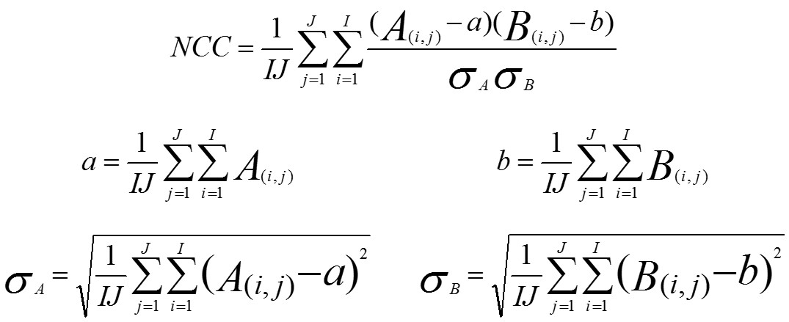
Normalized Cross-Correlation (NCC):
NCC values range from -1 to 1, with 1 indicating perfect similarity between the two images.
It is a metric that is used to compare two images based on their pixel values.
NCC is a measure of how well the pixels in one image match the pixels in another image.
NCC values range from -1 to 1, with 1 indicating a perfect match between the two images.

Slide 30
Experiment 1 on USC-sipi data set
Taking 24X24 watermark image
Embed size 4608 bits
IMAGE | MSE | PSNR | SSIM
LENA | 1.24997 | 47.16 | 0.99968
AIRPLANE | 1.38722 | 46.71 | 0.99960
ELAINE | 1.45079 | 44.23 | 0.99896
SAILBOAT | 1.83262 | 43.60 | 0.99967
PEPPER | 1.23345 | 44.67 | 0.99829
SPLASH | 1.25542 | 45.02 | 0.99962
TANK | 1.2349 | 42.72 | 0.99976
BARBARA | 1.1129 | 44.15 | 0.99994
GOLD HILL | 1.3472 | 43.10 | 0.99935
Table1 : Results on USC-SIPI Dataset using the proposed method

Slide 31
Experiment 2 on USC-sipi data set
Taking EPR as Watermark
Embed size 932 bits
IMAGE | MSE | PSNR | SSIM
LENA | 0.4654 | 51.45 | 0.9999
AIRPLANE | 0.5165 | 50.99 | 0.9998
ELAINE | 0.8912 | 48.63 | 0.9997
SAILBOAT | 1.3038 | 47.96 | 0.9998
PEPPER | 0.4322 | 51.01 | 0.9999
SPLASH | 0.5233 | 50.89 | 0.9998
TANK | 0.4824 | 50.62 | 0.9998
BARBARA | 0.5949 | 49.23 | 0.9997
GOLDHILL | 0.6300 | 50.13 | 0.9998
Table2 : Results on USC-SIPI Dataset using the proposed method

Slide 32
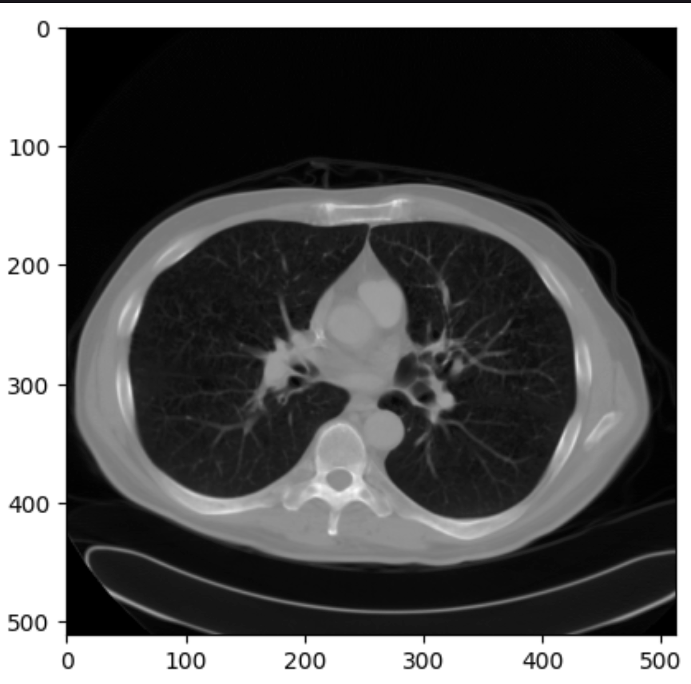
Experiment 3 on medical image
Taking EPR as Watermark
Cover image
Stego Image
Data recover 100% without attack
Medical image source: https://www.kaggle.com/datasets/kmader/siim-medical-images

Slide 33
Watermarking attacks
Different types of watermarking attacks.

Slide 34
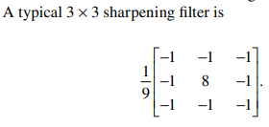
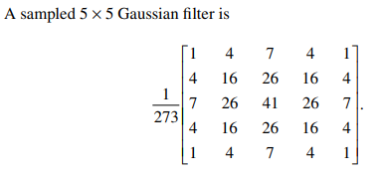
Attacks by filtering:
Filtering indicates the image processing operation in frequency domain.
We first compute the Fourier transform of the image, multiply the result by a filter transfer function, and then perform the inverse Fourier transform. This idea behind sharpening is to increase the magnitude of high-frequency components relative to low-frequency components. The high-pass filter in the frequency domain is equivalent to the impulse shape in the spatial domain.

Slide 35
Attacks by croping:
Cropping an image involves selecting a specific region or aspect of the image and discarding the rest. By doing so, the cropped portion is removed from the visible frame, potentially changing the visual narrative or removing critical information.
Attacks by jpeg coding distortion:
JPEG, which reorders information in such a way that an obscure perception of the whole image is available rather than a brittle perception of just a small portion after only a small part of the image has been downloaded. Although JPEG could reduce an image file size to about 5% of its normal size, some detail may be lost in the compressed image.
Attacks by scaling:
Sometimes when we scan a printed image or adjust its size for electronic publishing, image scaling may occur. This should be especially noted as we move increasingly in the direction of web publishing. An example is when the watermarked image is first scaled down (or down-sampled) by reducing both length and width by one-half—that is, by averaging every 2 × 2 block into a pixel. This quarter-sized image is then scaled up (or up-sampled) to its original size through the interpolation method.

Slide 36
Applying cropping attack
Croping 80px on 4 sides
IMAGE | MSE | PSNR | SSIM
LENA | 0.21734 | 54.75958 | 0.99995
AIRPLANE | 0.51654 | 54.63315 | 0.9999
ELAINE | 0.5353 | 50.8444 | 0.9998
SAILBOAT | 0.3865 | 52.2587 | 0.9979
PEPPER | 0.04497 | 61.6006
SPLASH | 0.16622 | 55.9241 | 0.9899
TANK | 0.4563 | 50.976 | 0.9929
BARBARA | 0.87100 | 48.7306 | 0.9998
GOLD HILL | 0.2534 | 54.0925 | 0.9999
Table3: reconstruct image vs cover after cropping attack
The watermark EPR data is successfully recovered after cropping attack

Slide 37
Time Complexity Analysis (embedding and Extraction)
­Haar transformation: O(m*n)
Computing Histogram: O(m*n)
Finding Shifting point: O(n/2) average case
Histogram Shifting: O(m*n)
Inverse ­Haar transformation: O(m*n)
Decoding process: O(m*n)
Reversible CoverImage: O(m*n)

Slide 38
References
Vidyasagar M. Potdar, Song Han, Elizabeth Chang, 2005, 3rd IEEE International Conference on Industrial Informatics, A Survey of Digital Image Watermarking Techniques, Curtin University of Technology, Perth, Western Australia.
Piyu Tsai, Yu-Chen Hu, Hsiu-Lien Yeh, 2008, Reversible Image Hiding Scheme using Predictive Coding and Histogram Shifting, National United University, Miaoli, Taiwan.
C. Qin, C.-C. Chang, Y.-H. Huang, L.-T. Liao, (2013), An Inpainting-assisted reversible steganographic scheme using a histogram shifting mechanism, IEEE Trans. Circuits Syst. Video Technol. 23
Sunil Lee, Student Member, IEEE, Chang D. Yoo, Member, IEEE, and Ton Kalker, Fellow, IEEE, 2007, Reversible Image Watermarking Based on Integer-to-Integer Wavelet Transform, IEEE TRANSACTIONS ON INFORMATION FORENSICS AND SECURITY, VOL. 2, NO. 3, SEPTEMBER 2007.
Hêmin Golpîra1 , Habibollah Danyali, 2009, Reversible Blind Watermarking for Medical Images Based on Wavelet Histogram Shifting, University of Kurdistan, Sanandaj, Iran.
Piyu Tsai, Yu-Chen Hu, Hsiu-Lien Yeh, 2008, Reversible Image Hiding Scheme using Predictive Coding and Histogram Shifting, National United University, Miaoli, Taiwan.
Hamza A. Ali, Sama’a A. K. Khamis, 2012, Robust Digital Image Watermarking TechniqueBased on Histogram Analysis, University of Basrah, Iraq.

Slide 39
References
8. Fridrich, J., (1999). Applications of data hiding in digital images. IEEE, 5th International Symposium on Signal Processing and Its Applications, vol.pp.9.
9. A. Nissar, A.H. Mir, Classification of steganalysis techniques: a study, Digit. Signal Process. A Rev. J. 20 (2010) 1758–1770, doi:10.1016/j.dsp.2010.02.003
10. R. Chandramouli, M. Kharrazi, N. Memon, Image steganography and steganalysis: Concepts and practice, Lect. Notes Comput. Sci. (Including Subser. Lect. Notes Artif. Intell. Lect. Notes Bioinformatics). 2939 (2004) 35–49
11. Li, Bin & He, Junhui& Huang, Jiwu& Shi, Y.Q.. (2011). A survey on image steganography and steganalysis. Journal of Information Hiding and Multimedia Signal Processing
12. Katzenbeisser, S. and Petitolas, F., (2000). Information hiding techniques for steganography and digital watermaking. Artech House, Taylor and Francis.

Slide 40
Thank you
Thank you for bearing with us!

